Slide 1



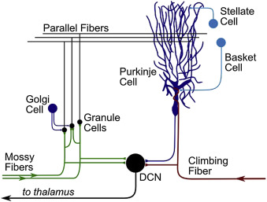
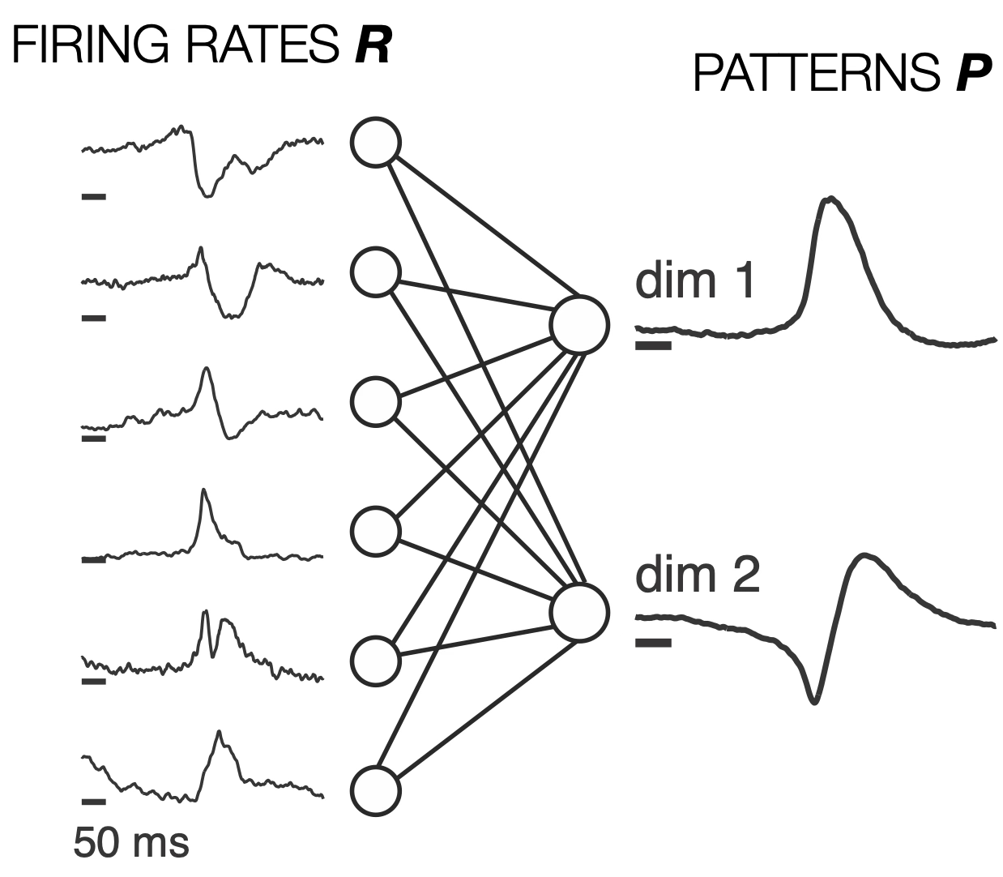
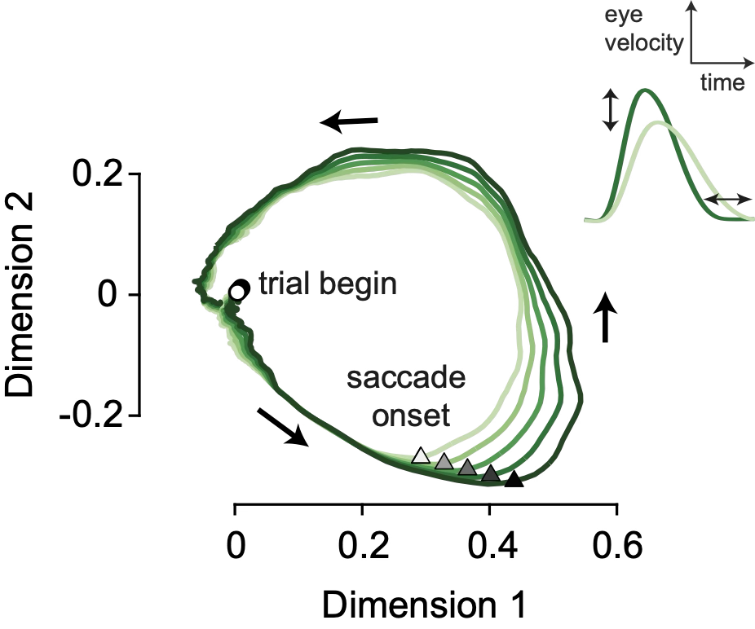
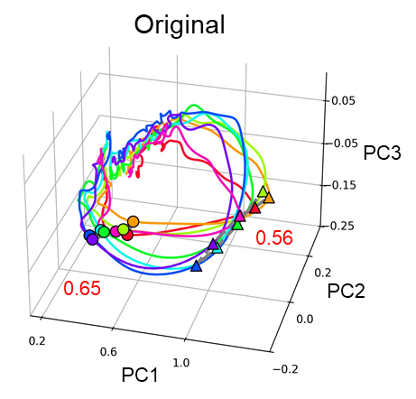
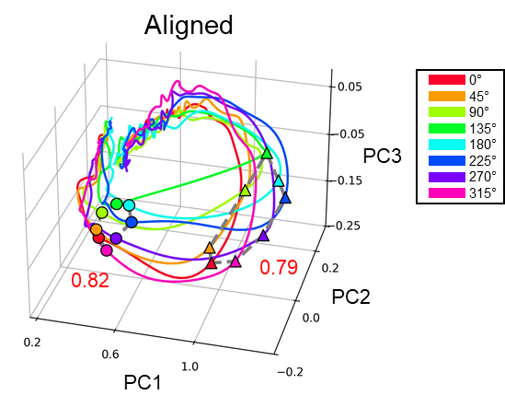
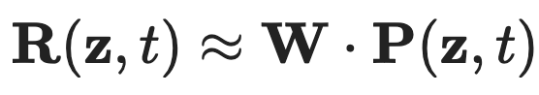
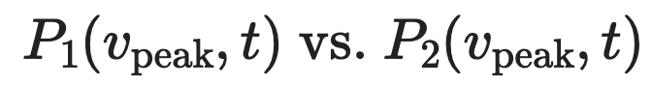
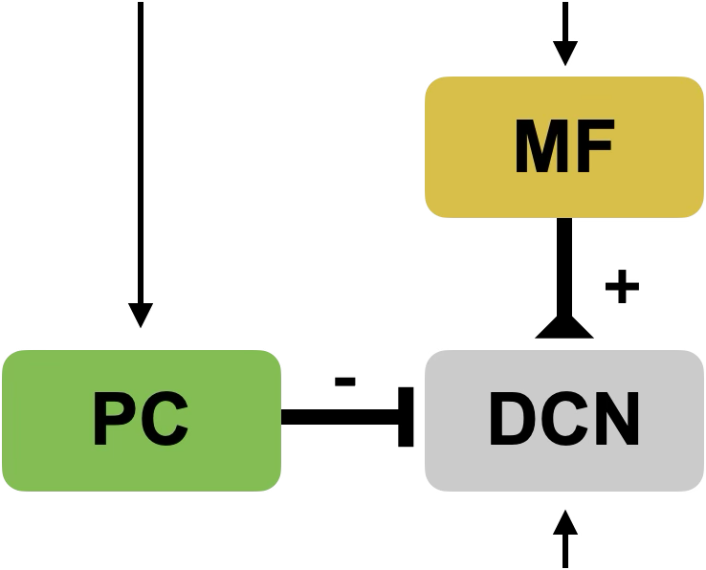
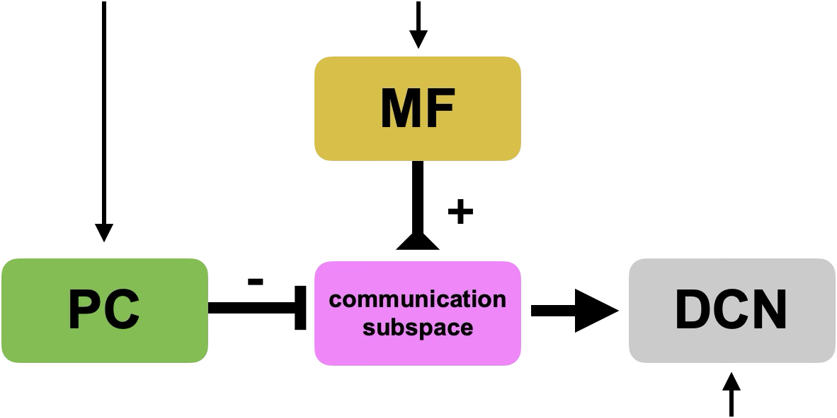
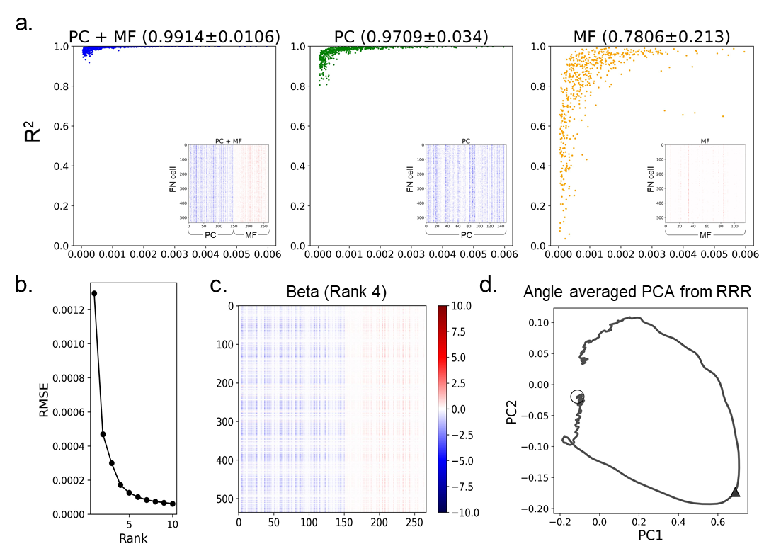
Multidimensional dynamics of the cerebellar output neurons encoding saccadic eye movement
Jisub Bae¹, Zong-peng Sun², Peter Thier² & Sungho Hong^{1†}
¹Center for Cognition and Sociality, Institute for Basic Science, South Korea; ²Dept. of Cognitive Neurology, Hertie Institute for Clinical Brain Research, University of Tübingen, Germany; †sunghohong@ibs.re.kr
Introduction
Direction-independent latent dynamics underlies FNN manifolds
Deep cerebellar nuclei (DCN)
θ = 135°
θ-dependent coefficients
θ-independent latent dynamics
model performance
≈
×
☞
firing rate individual neurons
weight matrix
neural manifold
gain matrix
latent dynamics
Final output region of the cerebellum (red) integrating the mossy fiber and Purkinje cell inputs (green),
Fastigial nucleus (FN), a DCN region involved in eye movement, remains poorly understood due to difficulty of recording from this area.
We analyzed the recordings from FN neurons (FNN; n=67) by Sun et al. [1] in rhesus monkeys performing saccadic eye movement tasks (see below).
FNNs have intrinsic reference directions [3] controlling their spike latency coding of eye movement directions
measure θ-dependent latency
create an n(=67)×8 matrix
multi-dimensional scaling to extract θ_{Δ}
Neural manifold (in the cerebellum)
∆(θ)
cell 1
cell 10
FNN manifold as P(θ,t)
FNN manifold as P(θ-θ_{Δ},t)
dimension 3
dimension 3
A small number of patterns (dimensions) explaining a large fraction of cell-to-cell variability in the neural population activity,
Highly successful at explaining the population activity of various neurons in many brain regions, including mossy fibers and Purkinje cells in the cerebellum [2] (figures above: Purkinje cell case).
What about FNNs, their common postsynaptic targets?
dimension 2
dimension 2
dimension 1
dimension 1
Data-driven network models show that FNN population activity is dominantly influenced by the Purkinje cell manifold
Results
direct projection models
communication subspace models [2,4]
On average, FNNs prominently burst like mossy fibers
neural data in ref. [2]
neural data in ref. [2]
saccade eye movement task
average firings of all FNNs in our data
mossy fibers
movement onset
fixation
our FNN data
performance of direct projection models
our FNN data
target
Purkinje cells
based on neural data in ref. [2]
signal-to-noise ratio
FNN activity dimensionally reduces like Purkinje cells
performance of communication space models
model-generated latent dynamics (d=4)
total variance explained by dimensions
FNN manifold examples
MF/PC-to-FNN weight matrix (d=4)
FNNs
mossy fibers
Purkinje cells
θ = 0°
θ = 135°
85%
movement offset
offset
dimension 2
onset
onset
Acknowledements
This work was supported by the Center for Cognition and Sociality (IBS-R001-D2), Institute for Basic Science, South Korea.
References
Sun et al. (2016) Eur J Neurosci 44, 2531-42.
Markanday, Hong et al. (2023) Nat Commun 14, 2548.
Fakharian et al. (2025) Science 388, 869-75.
Semedo et al. (2019) Neuron 102, 249-59.
dimension 1
dimension 2
dimension 1

